Slide 1
School of Information Technology
ICT302
Information Technology Professional Practice Project
ITP3
Introduction to Project Management

Slide 2
Acknowledgement
of Country
We acknowledge that Murdoch University is situated on the lands of the Whadjuk and Binjareb Noongar people.
We pay our respect to their enduring and dynamic culture and the leadership of Noongar elders past and present.
The boodjar (country) on which Murdoch University is located has for thousands of years, been a place of learning. We at Murdoch University are proud to continue this long tradition.
Notes:
South Street
We acknowledge that Murdoch University is situated on the lands of the Whadjuk and Binjareb Noongar people.
We pay our respect to their enduring and dynamic culture and the leadership of Noongar elders past and present.
The boodjar (country) on which Murdoch University is located has for thousands of years, been a place of learning. We at Murdoch University are proud to continue this long tradition.

Slide 3
Objectives
Identify the necessity of project management
Define a project
Describe the project knowledge areas
Understand what is involved in project management
Describe the role and skills of a project manager
Identify the project processes

Slide 4
TOPIC SUMMARY
A project has several attributes, such as being unique, temporary and developed incrementally
As the number and complexity of projects continue to grow, it is becoming even more important to practice good project management
A framework for project management includes stakeholders, knowledge areas, tools and techniques, and creating project portfolios to ensure enterprise success
Successful project managers must possess and develop many skills and lead their teams by example

Slide 5
Introduction
.
Many organizations today have significant interest in project management. WHY?
PMI’s Pulse of the Profession™ research (2013), which is consistent with other studies, shows that fewer than two-thirds of projects meet their goals and business intent (success rates have been falling since 2008), and about 17 percent fail outright.
See the results from 2021 in next slide
The cost of unsuccessful development projects in 2020 is estimated at $260 billion, according to a report by Synopsys and the Consortium for Information & Software Quality.

Slide 6
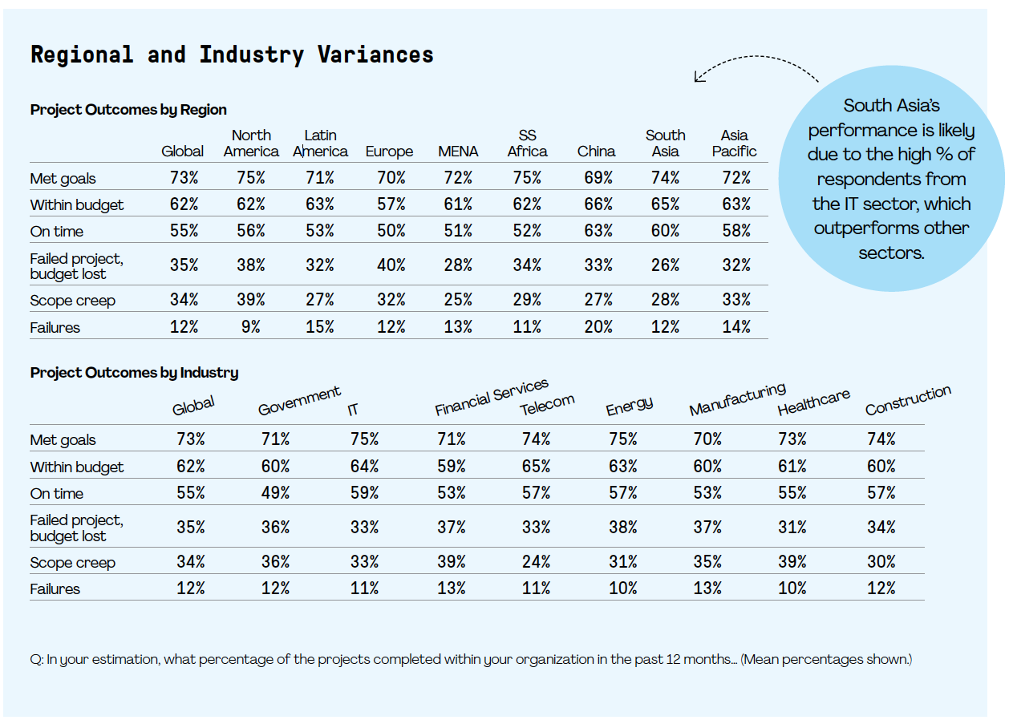
PM Performance 2021 PMI 2021 Pulse of the Profession® www.pmi.org

Slide 7
Project Management Statistics
Worldwide IT spending continues to grow
Project management will continue a decade-long trajectory of growth. From 2010 to 2020, as the profession grows by over US$6.6 trillion, the global economy is seeing 15.7 million new project management roles created in seven project-intensive industries, according to PMI’s 2013 Project Management Talent Gap Report.
Australian Median Project Practitioner Salary:
AUD$132,000
Notes:
7

Slide 8
What Is a Project?
A project is a temporary endeavor undertaken to create a unique product, service, or result*
NOTE: this does not refer to operations, which is work done to sustain the business
A project ends when its objectives have been reached, or the project has been terminated
Projects can be large or small and may take a shorter or longer time to complete
*PMI, A Guide to the Project Management Body of Knowledge (2004), p. 5.

Slide 9
Project Attributes
A project:
Has a unique purpose
Is temporary (defined life span)
Is developed using progressive elaboration
Requires resources from various areas
Should have a primary client or sponsor
The project client usually provides the direction and funding for the project
Involves uncertainty / risk
Notes:
9
Has a unique purpose – well defined objective
Is temporary – definite beginning & end
Is developed using progressive elaboration – developed in increments as elements broadly defined at the outset, become clearer
Requires resources, often from various areas – people, hardware, software etc – often crosses business unit boundaries
Should have a primary customer or sponsor
The project sponsor usually provides the direction and funding for the project
Involves uncertainty/risk – uniqueness causes these and makes management challenging as well as necessary

Slide 10
Why Projects Fail
Only the project team is interested in the end result
Insufficient resources are allocated
No one is in charge
The project lacks structure / detail
The project is not tracked against its plan
The project team is not communicating
The project strays from its original goals

Slide 11
Why Projects Fail
Solving the wrong problem
Poor problem definition and analysis
Project is too ambitious
Lack of management / support and user involvement
Inadequate design / testing / implementation
Users can’t use the system effectively
All of these problems can be attributed to poor project management?

Slide 12
How Do IT Projects Differ?
A unique combination of software, hardware and network
Imprecise requirements
Immaturity of the discipline of developing information systems
Lack of experienced IT project managers
Speed of technological change, making past experience less useful than in many other disciplines

Slide 13
Examples of IT Projects
A help desk or technical worker replaces laptops for a small department
A small software development team adds a new feature to an internal software application
A school / university campus upgrades its technology infrastructure to provide wireless Internet access

Slide 14
What is Project Management?
Project management is:
“the application of knowledge, skills, tools, and techniques to project activities in order to meet project requirements”
(PMI, A Guide to the Project Management Body of Knowledge (PMBOK® Guide), 2004, p. 8).

Slide 15
Advantages of
Project Management
Better control of financial, capital and human resources
Improved client relations
Shorter development time
Lower costs
Higher quality and increased reliability
Higher work-place morale

Slide 16
Project Requirements
All projects are required to be:
on time - how long should it take to complete?
on budget – what should it cost?
within scope - what work will be done?
These goals are often competing in what could be termed the project Triple Constraint
Quality should also be seriously considered in connection with the other constraints
It is the project manager’s duty to balance these often competing goals
Notes:
16
A quadruple constraint rather than triple

Slide 17
The Role of the Project Manager
Job descriptions vary, but most include responsibilities such as:
Planning
Scheduling
Coordinating
Working with a team to achieve project goals
97% of successful projects were led by experienced project managers
Notes:
17

Slide 18
Skills for Project Managers
Project managers need a wide variety of skills. They should:
Be comfortable with change
Understand the organization they work in, and those that they work with
Lead teams to accomplish project goals
Project managers need ‘hard’ & ‘soft’ skills:
Hard skills include product knowledge and knowing how to use various project management tools and techniques
Soft skills include being able to work with various types of people

Slide 19
Skills for Project Managers
Communication skills: Listens, persuades
Organizational skills: Plans, sets goals, analyses
Team-building skills: Shows empathy, motivates, resolves conflict
Leadership skills: Sets examples, provides vision (big picture), delegates, positive, energetic
Coping skills: Flexible, creative, patient, persistent
Technology skills: Experience, project knowledge

Slide 20
Most Significant Characteristics of Effective and Ineffective
Project Managers

Slide 21
The Project Management Profession
Communication skills: Listens, persuades
Organizational skills: Plans, sets goals, analyses
Team-building skills: Shows empathy, motivates, resolves conflict
Leadership skills: Sets examples, provides vision (big picture), delegates, positive, energetic
Coping skills: Flexible, creative, patient, persistent
Technology skills: Experience, project knowledge

Slide 22
Project Management Certification
PMI provides certification as a Project Management Professional (PMP)
A PMP has documented sufficient project experience, agreed to follow a code of ethics, and passed the PMP examination
The number of people earning PMP certification is increasing rapidly
PMI and other organisations are offering new certification programs

Slide 23
Project Management:
Tools and Techniques
Assist project managers and their teams in various aspects of project management
Specific tools and techniques include:
Project charters, scope statements, and Work Breakdown Structures (WBS)
Gantt charts, network diagrams (PERT), critical path analysis, critical chain scheduling
Cost estimates and earned value management

Slide 24
Project Management Software
There are currently hundreds of different products to assist in performing project management
Three main categories of tools:
Low-end tools: Handle single or smaller projects well;
Mid-range tools: Handle multiple projects and users Ms Project most popular
High-end tools: Also called enterprise project management software; often licensed on a per-user basis;

Slide 25
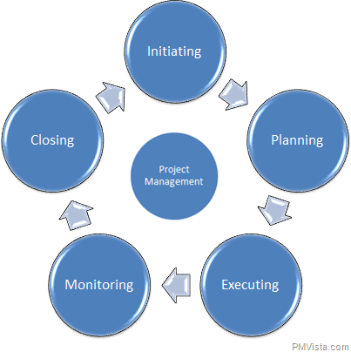
Project Management Knowledge areas and processes

Slide 26
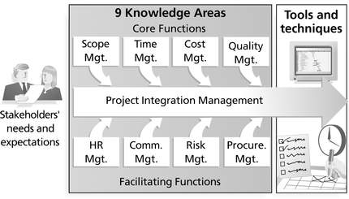
Project Management Framework
9 Areas
Source: Schwalbe, Kathy. Introduction to Project Management, p.10.

Slide 27
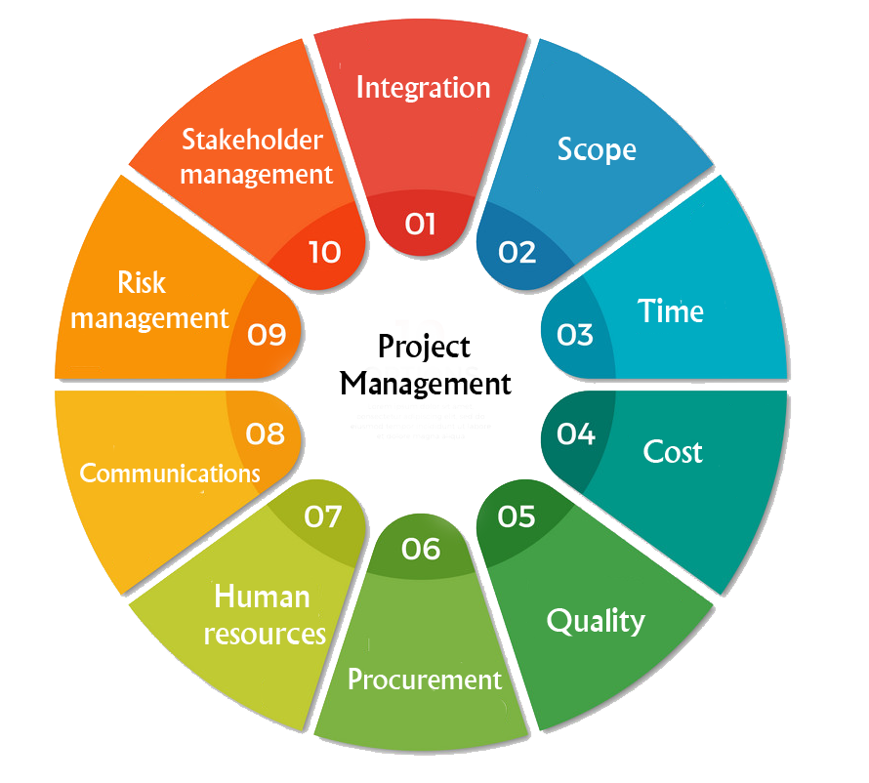
Project Management Framework 10 Areas

Slide 28
The Difference Between PROJECT SCOPE and Project Scope Management
PROJECT SCOPE is the overall or total
work to be performed in order to meet the
client’s requirements
This includes the work involved in creating the products of the project, and the processes used to create them (i.e. the functional and non-functional requirements)
In this unit, PROJECT SCOPE is essentially defined by the Requirements and Analysis document (R&A)

Slide 29
Project Management Knowledge Areas: Scope
Project scope management:
Includes the processes involved in defining PROJECT SCOPE (i.e. what tasks will be included and what will not be included in the project). It also includes managing and controlling all work for the duration of the project
Scope definition involves the breakdown of all tasks needed to successfully complete the project, and is typically achieved by representing all tasks in the Work Breakdown Structure (WBS), which decomposes the tasks hierarchically until only atomic tasks remain

Slide 30
Project Management Tools and Techniques: Scope
Scope management:
Scope statements
Requirements and Analysis Document
Work Breakdown Structures (WBS)
Statements of work
Scope verification techniques
Scope change controls

Slide 31
Project Management Knowledge Areas: Time
Project time management:
Estimation of how long all activities/tasks will take to perform, and creation of schedules based on these estimates to ensure timely completion of the project
Includes scheduling of milestones:
Specific
Measurable
Assignable
Realistic
Time-framed

Slide 32
Project Management Tools and Techniques: Time
Time management:
Gantt charts
Schedule performance measurements
Project network diagrams
Critical-path analysis

Slide 33
Project Management Knowledge Areas: Cost
Project cost management:
Performing cost estimates for all tasks to be undertaken for the duration of the project; preparing the budget based on these
Managing / monitoring / controlling cost estimates per task
Must consider the following in costing:
Project quality management
Ensuring the project will meet stated or implied needs

Slide 34
Project Management Tools and Techniques: Cost
Cost management:
Net present value
Return on investment
Cost estimates
Cost baselines
Cost management plans (including budget based on cost estimates)

Slide 35
Project Management Knowledge Areas: Quality
Quality is: “the degree to which a set of
inherent characteristics fulfills
requirements”
Project quality management:
Involves processes that ensure the product (and each task involved in developing the product) conforms to the requirements of the product and baseline quality standards
It also involves the ‘fitness for use’ of the final product and its components

Slide 36
Project Management Knowledge Areas: Quality
Project quality management processes include:
Quality planning: identifying which quality standards are relevant to the project and how to satisfy them
Quality assurance: periodically evaluating overall project performance to ensure the project will satisfy the relevant quality standards
Quality control: monitoring specific project results to ensure that they comply with relevant quality standards

Slide 37
Project Management Tools and Techniques: Quality
Quality management:
Quality assurance plans
Includes code reviews and thorough testing strategies
Quality metrics
Checklists
Quality control charts

Slide 38
Project Management Knowledge Areas: HR
Project human resource management:
Making the most effective use of people by:
Identifying the team (based on skills)
Acquiring the team
Developing the team
Managing the team
Getting the best out of human resources
People management skills / conflict resolution

Slide 39
Project Management Tools and Techniques: HR
Human resource management
Motivation techniques
Empathic listening (good communications)
Responsibility assignment matrices
Organizational charts
Team building exercises
Conflict resolution procedures

Slide 40
Project Management Knowledge Areas: Communications
Project communications management:
Involves generating, collecting, disseminating and storing project information
Includes setting communication standards – eg: who is responsible, preferred methods, etiquette, document srandards, etc
Includes storage and versioning of all project documentation (including code)
Though the importance is acknowledged, often the effort required is underestimated

Slide 41
Project Management Knowledge Areas: Communications
Tools and techniques:
Communication plans
Status reports
Meeting documentation
Data repositories / version control systems
Electronic / virtual communication media
Project web sites

Slide 42
Project Management Knowledge Areas: Stakeholder
Identification of stakeholders,
analysis of their expectations and influences,
development of appropriate strategies to work with the stakeholders
and executing the process

Slide 43
Project Management Knowledge Areas: Risk
Project risk management:
Involves identifying, analyzing and responding to the risks related to all project activities
Types of risks:
Market
Financial
Technological
Personal
Structure / process

Slide 44
Project Management Tools and Techniques: Risk
Tools and techniques:
Risk management plans including various risk analysis techniques:
Risk register, quantitative analysis (such as decision trees), etc
Probability / impact matrices
Risk rankings
Contingency / fallback plans

Slide 45
Project Management Knowledge Areas: Procurement
Project procurement management:
Involves the processes for identifying and acquiring the goods and services needed for the project from external sources
Includes the management of these processes and the acquisitions. The timely delivery of the goods and services is also part of the management process

Slide 46
Project Management Tools and Techniques: Procurement
Tools and techniques:
Make-or-buy analyses
Rent-or-buy analyses
Contracts
Request for proposals (RFP)
Supplier evaluation matrices

Slide 47
Project Management Knowledge Areas: Integration
Project integration management:
The coordination of all other 8 project management knowledge areas
Involves monitoring / controlling these for the duration of the project lifecycle
Project managers are responsible for this task
Many new project managers have trouble looking at the “big picture” and want to focus on too many details

Slide 48
Project Management Tools and Techniques: Integration
Tools and techniques:
Project management methodology
Project charters
Project management plans and software
Project review meetings
Lessons learned reports, etc

Slide 49
Topic Summary
As the number and complexity of projects continue to grow, it is very important to practice good project management
A project has several attributes, such as being unique, temporary and developed incrementally

Slide 50
Topic Summary
Successful project managers must possess and develop many skills and lead their teams by example
A framework for project management includes stakeholders, knowledge areas, tools and techniques, and creating project portfolios to ensure enterprise success

Slide 51
Peter Cole
p.cole@Murdoch.edu.au

